Slide 1
MAI Home
Reflections from the perspective of
social work
General introduction
Diana Zangari, staff member

Slide 2
SAAMO Limburg
  Who are we & what do we do?
We have existed for 32 years
78 staff members
+/- 800 volunteers
In addition to our supra-local projects, there are 39 agreements with 19 local authorities in Limburg.
50 projects

Slide 3
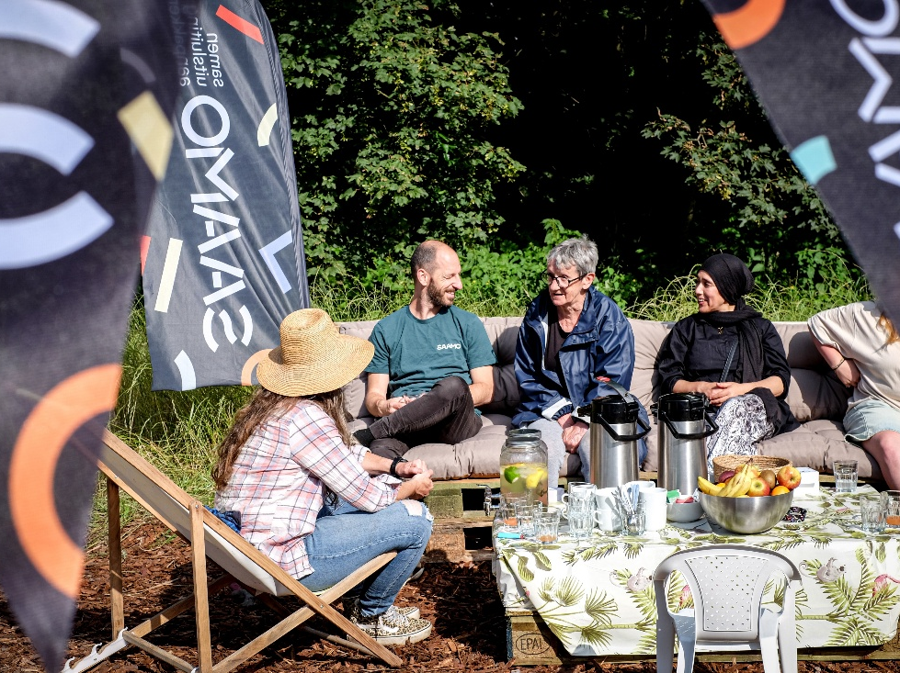

Slide 4
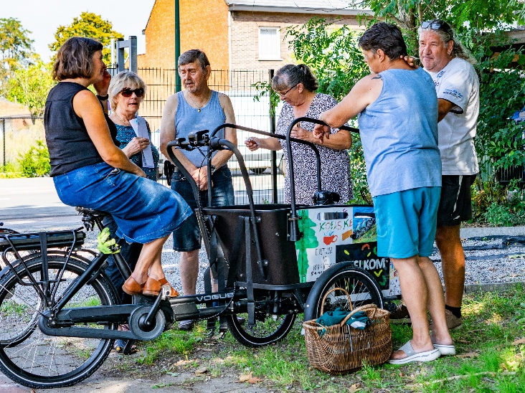

Slide 5
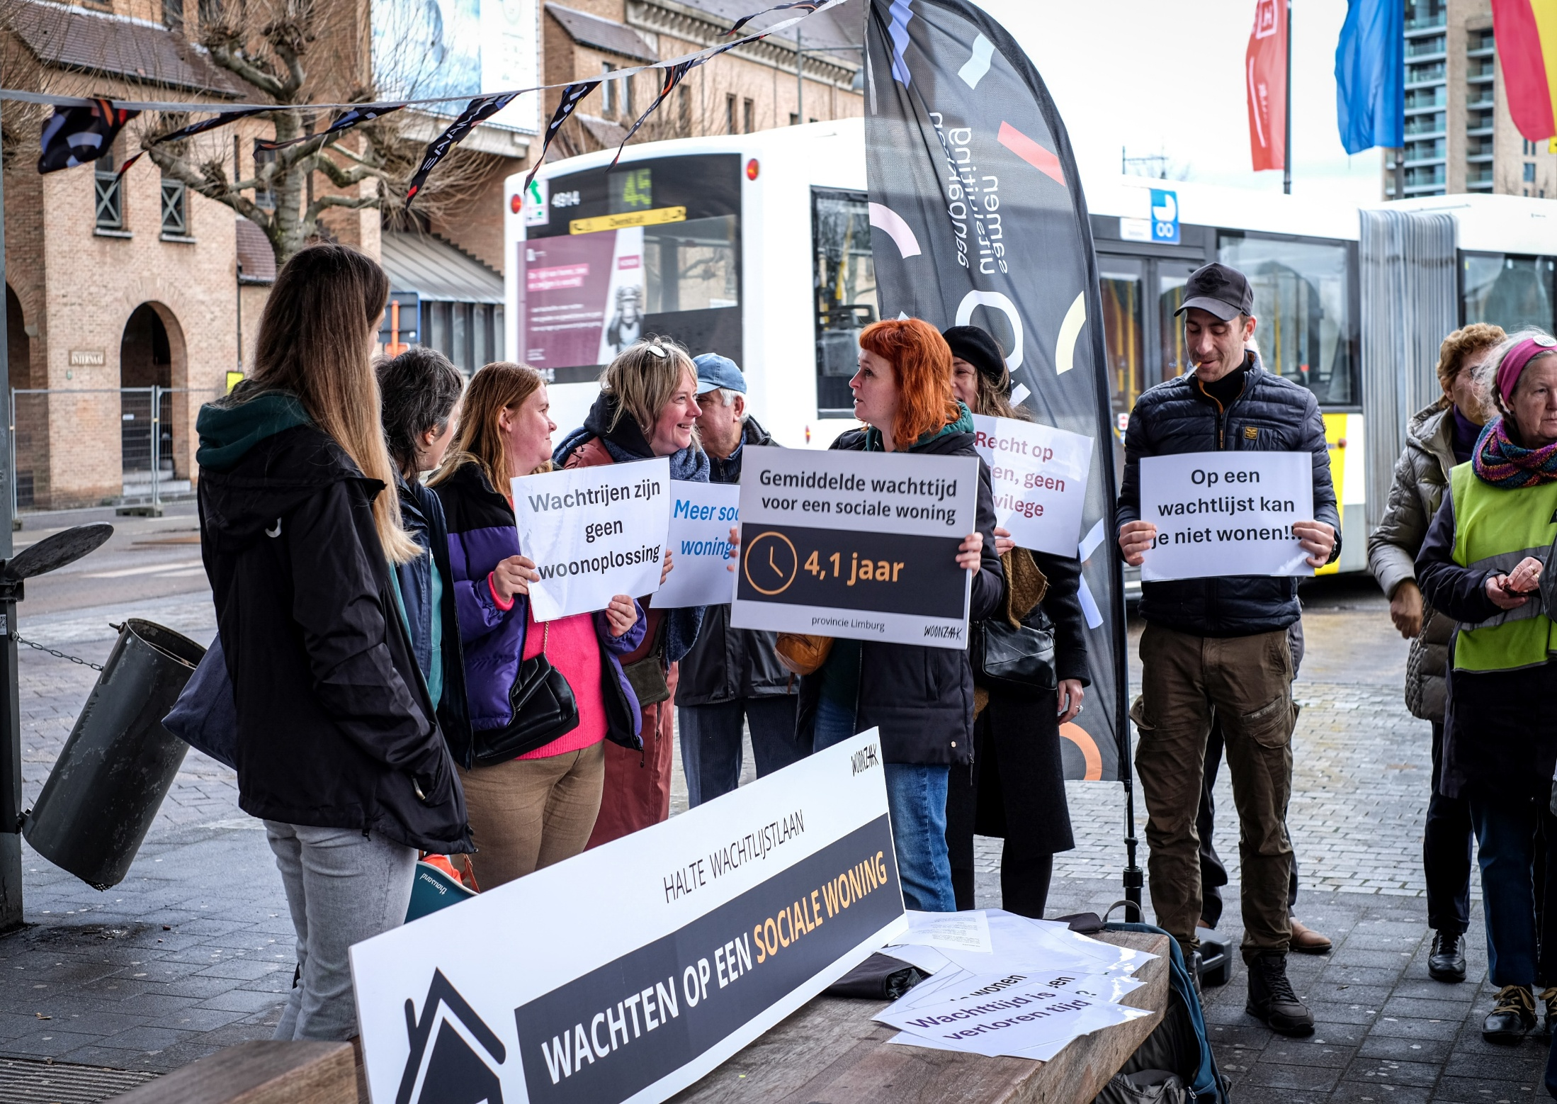

Slide 6
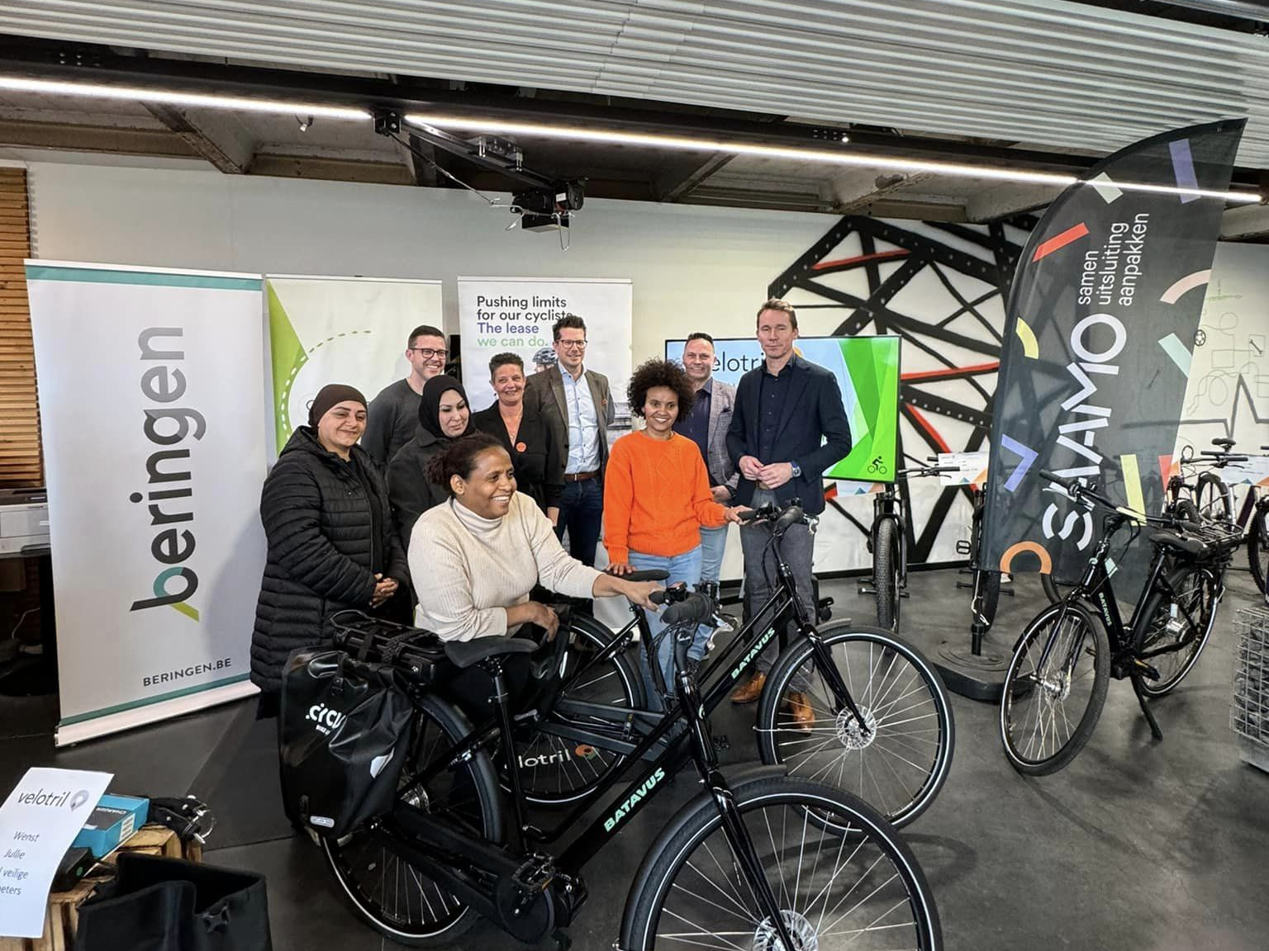

Slide 7
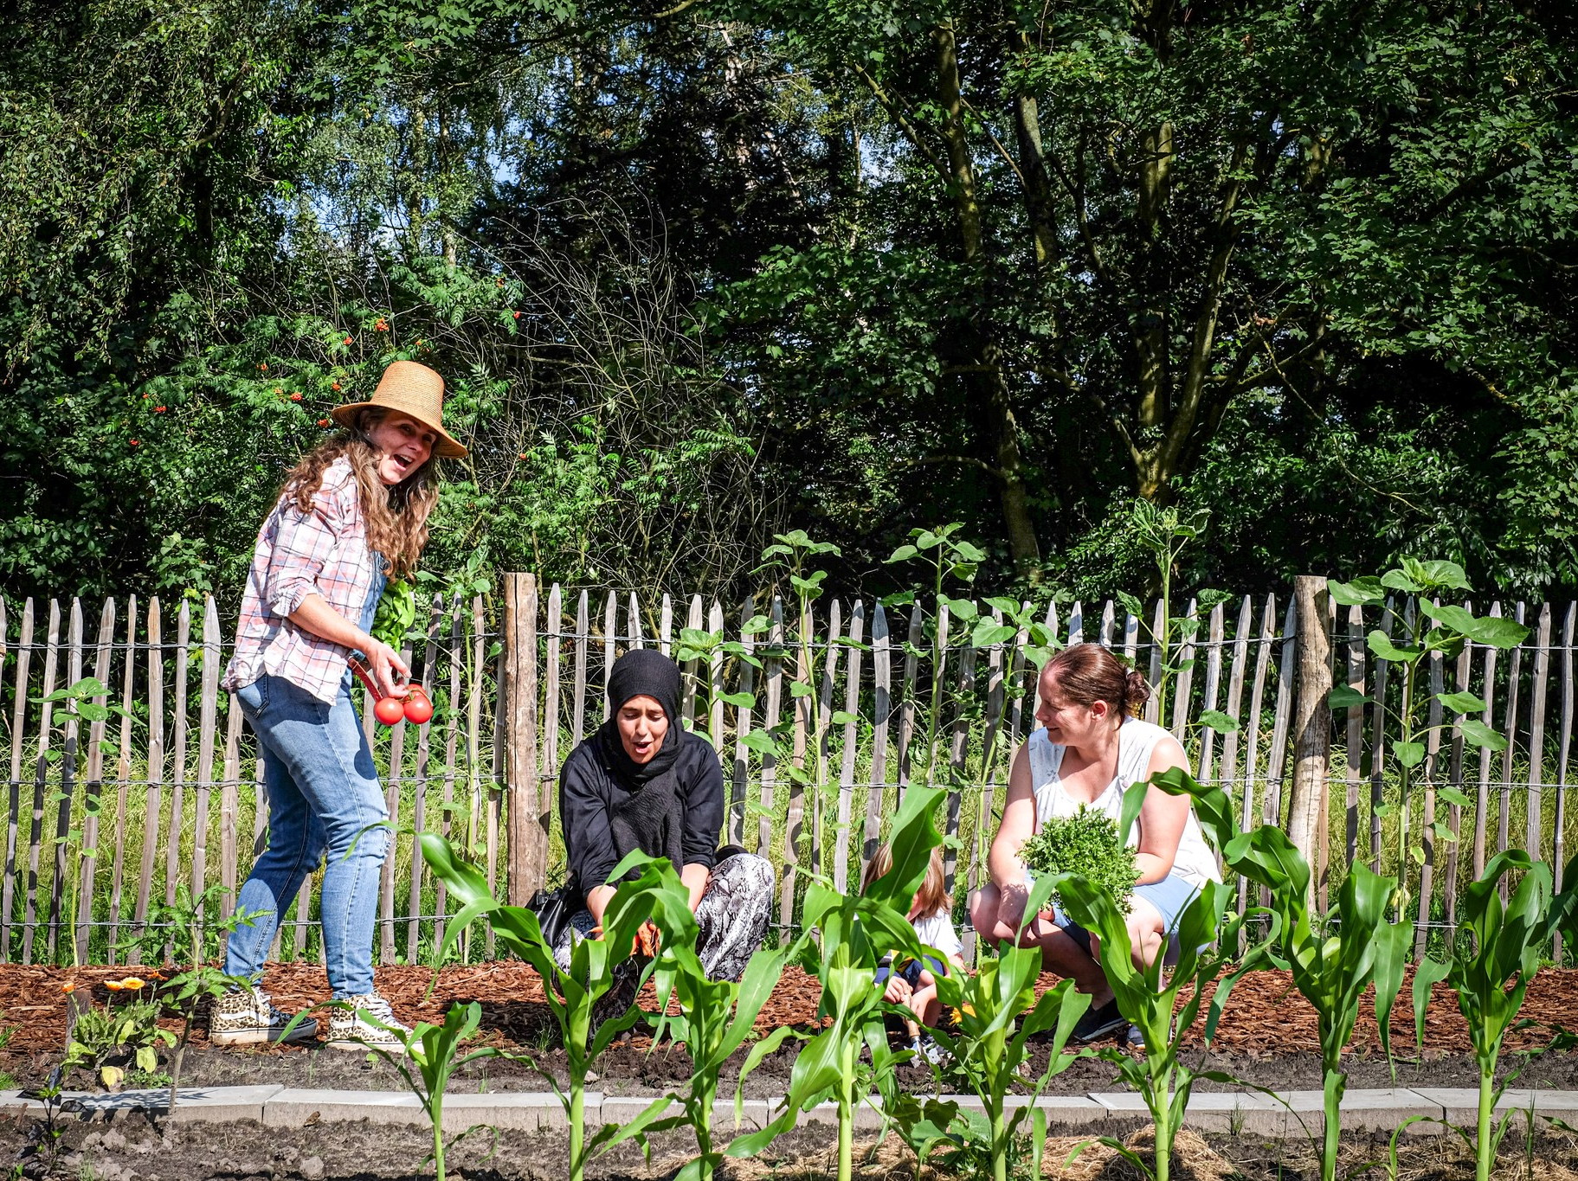

Slide 8
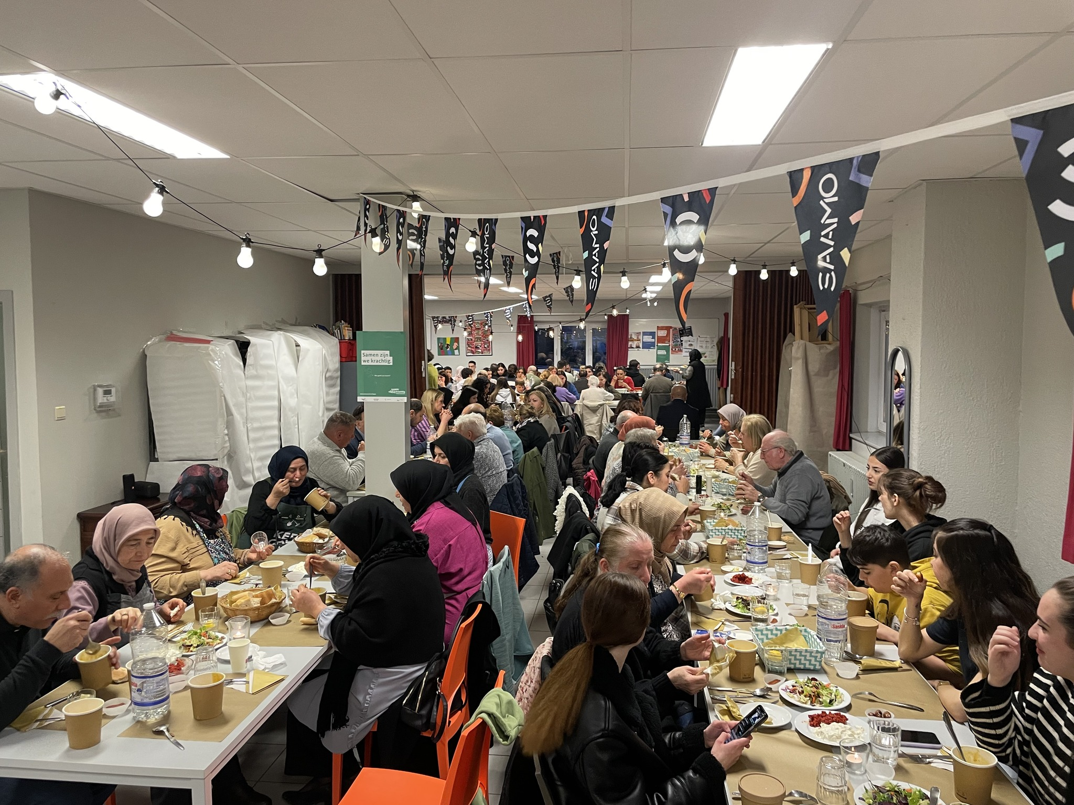

Slide 9
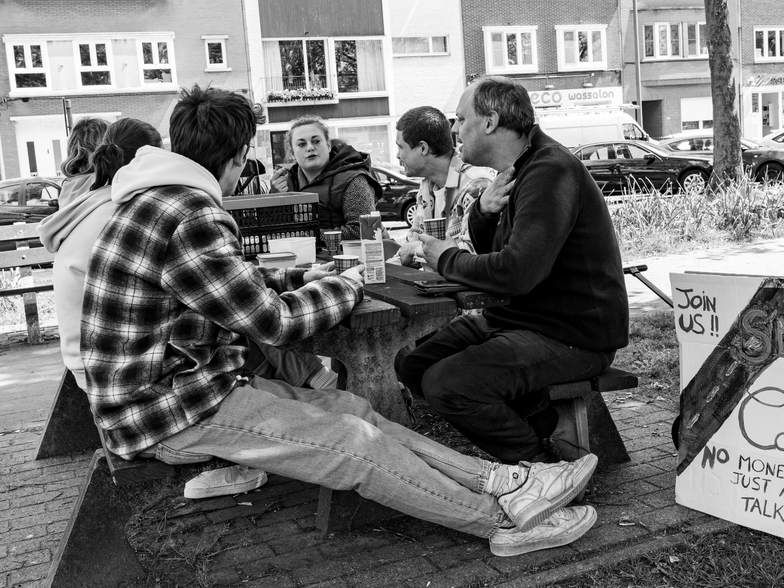

Slide 10
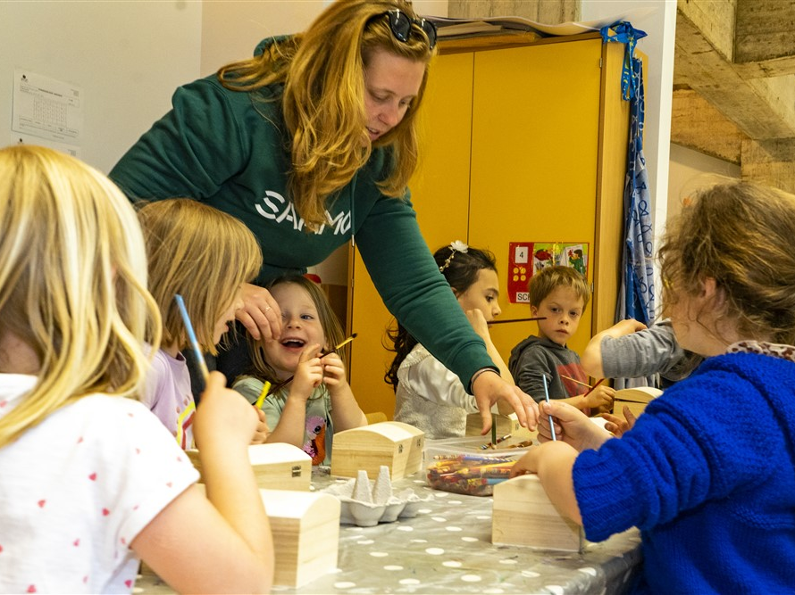

Slide 11
SAAMO Limburg
  Who are we & what do we do?
    TACKLING EXCLUSION TOGETHER
    Working on the basic rights of people facing social disadvantage and exclusion
    Achieving visible solutions to common problems
    With explicit participation of the people themselves
    Within the framework of the Social Development sector

Slide 12
SAAMO Limburg
  Who are we & what do we do?
    HOW DO WE DO THIS?
    Empowering people so that they:
      Participate in social life
      Can speak up to influence policy
    Influencing policy so that:
      measures are adapted to people’s needs
      Policy creates space to listen to people

Slide 13
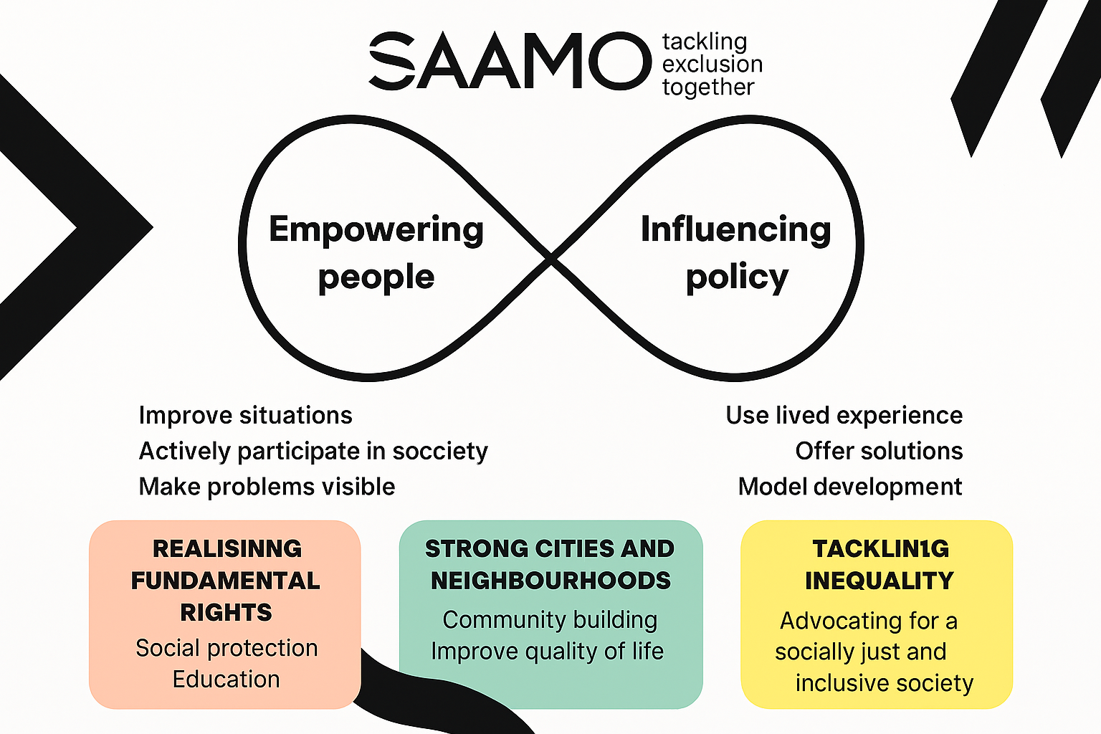
Notes:
SAAMO Limburg’s core mission involves, on the one hand, empowering people in socially vulnerable positions and, on the other, working alongside them to secure structural policy measures that enable the realization of their fundamental social rights.
This project allows us to fulfill both aspects of this mission by collaborating with residents, researchers, and housing associations to address energy poverty.

Slide 14
Mai Home: involved WP 5&6
  Our main role
    Representation of vulnerable target groups
    Safeguarding trust, privacy, and ethical aspects
    Strengthening participation of residents
    Advisory role on communication
    Contribution to pilot activities and engagement
    Development of/advice on methodologies for interaction
    Input on participation and social approach
    Review and provide feedback (e.g. on tools like the mobile app)
    from the perspective of residents’ interests
    Involvement in group pilots: help participants during group pilots and learning activities.

Slide 15
Mai Home
  Why participate?
    Sharing reflections from perspective of people in vulnerable situations
    Maximise involvement of the target group
    Stronger communication tools
      presentations researchers
      adventure book tool kitchen table conversations
    Sharing developed SAAMO material like infographics & instruction sheets on saving energy
    Learning and capacity building SAAMO: to learn to strengthen our own future initiatives addressing energy poverty.
Notes:
The advice we receive regarding tools tailored to our target audience will enable us to continue addressing energy poverty in the future.

Slide 16
Reflections from the perspective of social work
21 april 2026
Hester Vanlangenaeker
Community Worker

Slide 17
Disclaimer
Reflections are based on feedback & input with projectpartners directly in contact with residents & tenants:
WiL, Weller, Leefgoed & Tiwos

Slide 18
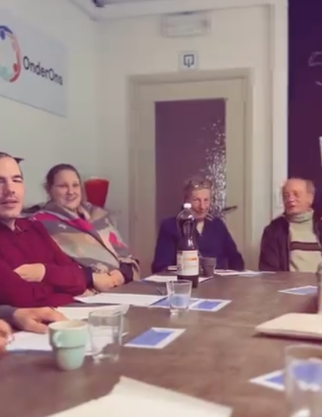
Mai Home
  Celebrations
Proximity & personal guidance
Home visits
Fixed point/ person of contact
Concrete advice
Learning from eachother
Collaboratin between partners
Notes:
What worked well?
Proximity en personal guidance and contact
Home visit – taking the time to go to the residents
1 person (fixed point) works best
Concrete advise on how to deal with an specific challenge – the more concrete, the better
Learning from eachother – when we brought people together and they were able to interact, they could share there sollutions to collective challenges

Slide 19
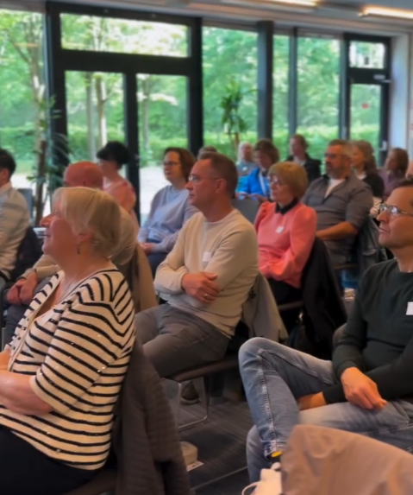
Mai Home
  Challenges
Difficult or technical language
Limited digital skills
Advice was hard to implement
Uncertainty about project objective
Insufficient feedback on measured results
Not on top of mind
Really saving energy?
Notes:
Difficult or technical language – talking about energy-poverty en technologigal sollutions can get realy complicated
Limited digital skills – not everybody can work with a smartphone or is digitally skilled, this was something we had to keep in mind
Advice was hard to implement – because it often requires changing behaviour, and that comes with it's own challenges, furthermore: some of the changes in a residents apprtement or house were of a more structural nature, which means the resident could not change or implement this in there house.
Uncertainty about project objective -
Insufficient feedback on measured results
Not on top of mind – when you are facing financial and aditional challenges, thinking about energy is often not high on your prioritylist
Really saving energy? - from the perspective of the participants, it was not always visible what the impact was.

Slide 20
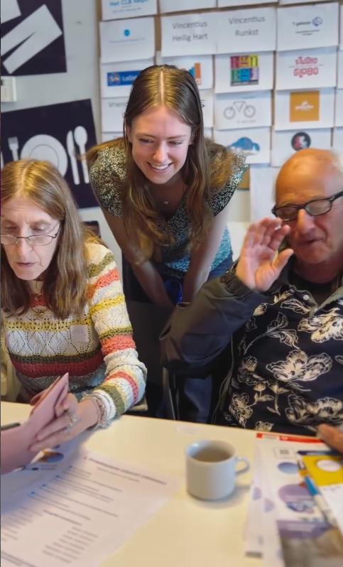
Mai Home
  Impact for the tenants
    Community building
    Positive contact with their housing corporation
    Learned to work with a new app
    Thinking about own living skills to save energy
Notes:
Community building – social interaction between the tenant, connecting the residents and initiation new relationships
Positive contact with their housing corporation – in some cases the relation between the tenant and the housing corporation was
Learned to work with a new app
Thinking about own living skills to save energy

Slide 21
Mai Home
Instagram
  Lessons learned
Trust before technology
There is no such thing as THE participant/ resident
Changing behaviour requires small steps
Energy-poverty is about so much more
Technology is a means, not an end
Notes:
Lessons learned
Trust before technology
Participation was at it's best when there was a feeling of trust
2. There is no such thing as THE participant/ resident
context, housing, financial stability, motivation, …
3. Changing behaviour requires small steps
4. Energy-poverty is about so much more
Behaviour, motivation, capacity, living conditions, …
5. Technology is a means, not an end
The evaluation recommends using data, sensors, and AI as supportive tools rather than replacing human interaction.

Slide 22
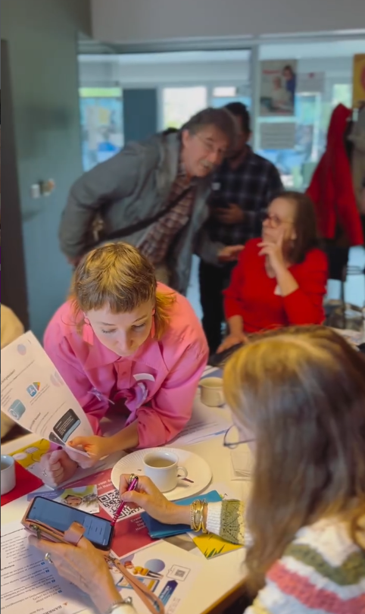
Mai Home
  Recommendations
Trust and proximity
Involve residents
Differentiate
Keep it simple
Feedback
Peer learning and social interaction
Allow sufficient time within projects for social and relationship-building work.
Notes:
Start with trust and proximity.
Involve residents from the very beginning in the design of methods and tools.
Differentiate according to resident profiles. - There is no such thing as THE resident – take people context in to account
Keep technology simple and supportive. - technology can get complicated , try to keep it simple
Provide feedback to residents about how their participation and data are being used. - communicate the proces, keep them posted
Create opportunities for peer learning and social interaction.
Allow sufficient time within projects for social and relationship-building work.

Slide 23
Questions?

Slide 24
Thank you for your attention!
  Zangari Diana
  Hester Vanlangenaeker
      SAAMO Limburg vzw
        www.saamolimburg.be

