Slide 1



MAI-HOME tool. Development of an AI-based Tool for Personalised Recommendations for Healthy Homes
Olivia Guerra-Santin, PhD · Parsa Safaee, MSc
26/08/2026

Slide 2
The starting point
Samen Duurzamer Wonen
More Sustainable Living Together
A renovation calculator for private homeowners.
samenduurzamerwonen.eu · Interreg V Flanders-Netherlands ENLEB.

Slide 3
Where this work sits
ACADEMIC RESEARCH
THE PROJECT
THE CONTEXT
TU Eindhoven
MAI-HOME
Social Housing
Built Environment. Social housing.
Interreg Vlaanderen-Nederland
Netherlands and Belgium
A tool for the people who live with the consequences.

Slide 4
User-building interaction and the performance gap
Behaviour not as problem but as a reaction to a need.
01
Lack of understanding
Heat pumps, heat recovery, low-temperature heating.
02
Counterintuitive interfaces
Lack of control and / or feedback. Mental models that do not match the (new) building.
03
Configurations that do not fit users
Designs based in standard household profiles.

Slide 5
The new context
TENANTS
HOUSING ASSOCIATIONS
Live with the consequences.
Make the choices.
DECISION POWER
DECISION POWER
Limited.
High.
Guerra-Santin et al. 2022; Bridi et al. 2022; Broers et al. 2022; Kowaltowski et al. 2024.

Slide 6
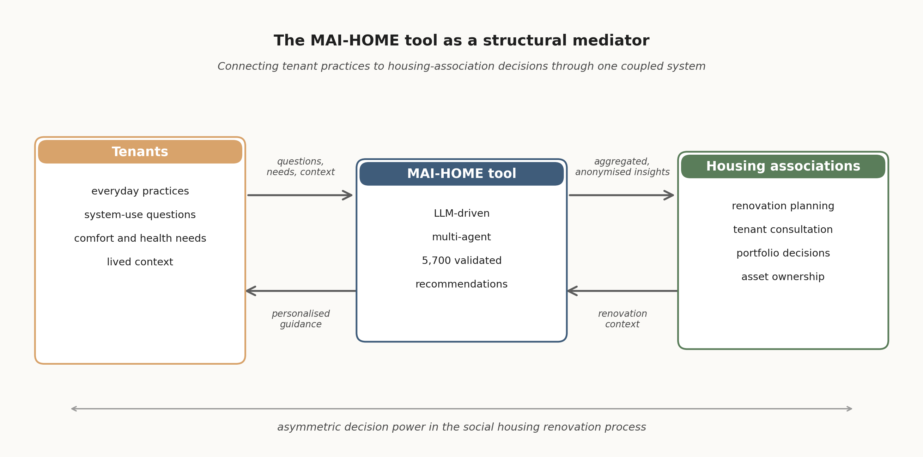
The insight
one conversation, two audiences
The same conversation produces personalised guidance for the tenant and anonymised, aggregated insight for the housing association.

Slide 7


The tool
LARGE LANGUAGE MODEL
AGENTIC WORKFLOW
Understands language.
Adds memory, planning, tools.
The model reads what the tenant says, and replies in the right language, at the right register.
Remembers what was said before.
Plans a multi-step response.
Calls tools · Telegram, validated dataset, weather.

Slide 8
Why a language model, not a sensor kit
Sensor-based monitoring
Hardware cost. Installation. Privacy. Limited reasoning.
the obvious first instinct
Rule-based recommender
Easily out of date. Hard to maintain.
the engineering default
LLM-driven multi-agent
Natural language. Anonymised. Modular. Scalable.
what MAI-HOME chose

Slide 9
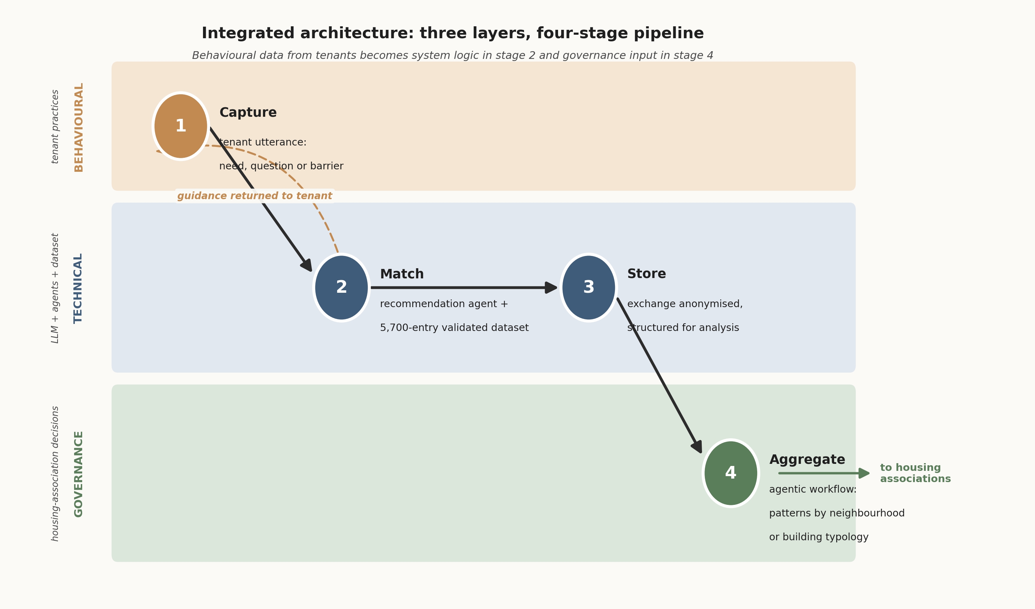
The architecture
Input from a tenant becomes governance input for a housing association, by way of the technical layer in between.

Slide 10
What the tool draws from
5,700
VALIDATED BY HUMANS AND AI
4
Human experts
Feasibility and Usability.
validated recommendations
Olivia Guerra-Santin
Parsa Safaee
Sahra Qodusi
Elena van der Ven
HEALTHY · ENERGY-EFFICIENT · LOW-COST
4
AI judges
Passive
Systems
Active
Systems
Hazard
& Safety
AI-as-a-Judge methodology.
Claude Opus 4.1
Gemini 2.5 Pro
Grok 4
Llama 4 Maverick
insulation, glazing, sun
heating, ventilation, appliances
moisture, electrical, water
Low-tech, low-cost guidance on daily practices and how to use home systems well.

Slide 11



Accessibility and ease of use
Telegram
Text or Voice
Native Language
Anonymised
no new app to learn
the residents choose
the LLM does the work
by design

Slide 12
Pilots in the Netherlands and Belgium
5
3 to 40
Lunch
Pilot sites
Participants
Format
across NL and Belgium
per pilot gathering
informal, in-person
WHAT WE OBSERVED
Most participants installed the tool independently.
Voice interaction reduced the typing burden for older residents.
Each site produced a structured picture of local tenant concerns.

Slide 13
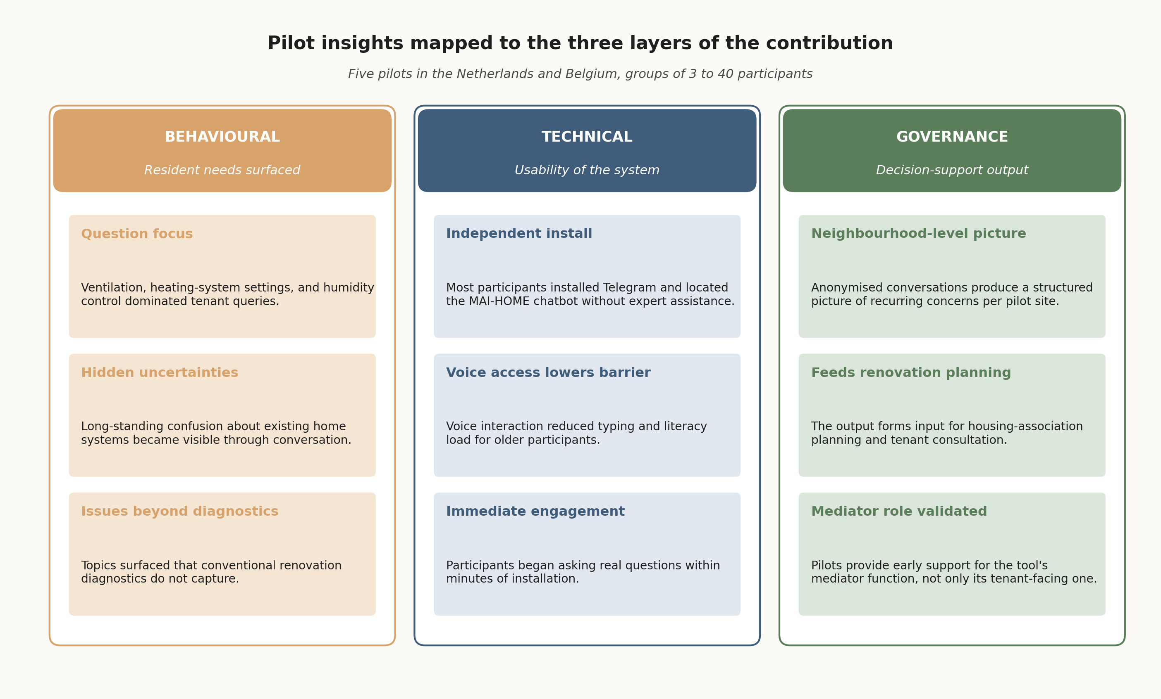
Results from pilots

Slide 14
one conversation, two audiences
FOR THE TENANT
FOR THE HOUSING ASSOCIATION
Personalised guidance
Aggregated insight
How to use the home, in their own language.
Low-cost adaptations, not capital-cost renovation.
Voice or text. Their own pace.
Recurring concerns at neighbourhood scale.
Where systems are failing their users.
Anonymised by design.

Slide 15
Building a tool that outlives the project
WHO OWNS IT. WHO MAINTAINS IT.
5
Housing associations as carriers
No sensor kit. No recurring hardware cost.
years
OF MINIMUM POST-PROJECT ACTIVE LIFE
Modular by construction

Slide 16
What comes next
PERSONALISATION
More contextual information
COLLABORATION
Feedback from housing associations
EXPANSION
Other groups, other regions
one conversation, two audiences

Slide 17

More information
MOOC
BOOKLET
Contact us
Olivia Guerra-Santin · o.guerra.santin@tue.nl · TU Eindhoven

Slide 18
Questions?
Olivia Guerra-Santin · o.guerra.santin@tue.nl · TU Eindhoven

